Slide 1
A Meta-Reinforcement Learning-Based Adaptive Robot Control for Human-Robot Collaboration in Personalized Production
Hin Chi Kwok, Chengxi Li,
Yatming Pang, Pai Zheng
Department of Industrial and Systems Engineering, The Hong Kong Polytechnic University, Hong Kong S.A.R., China

Slide 2
Overview
Motivation
Methodology
Experiments
Results & Demonstration
Discussions & Future Work

Slide 3
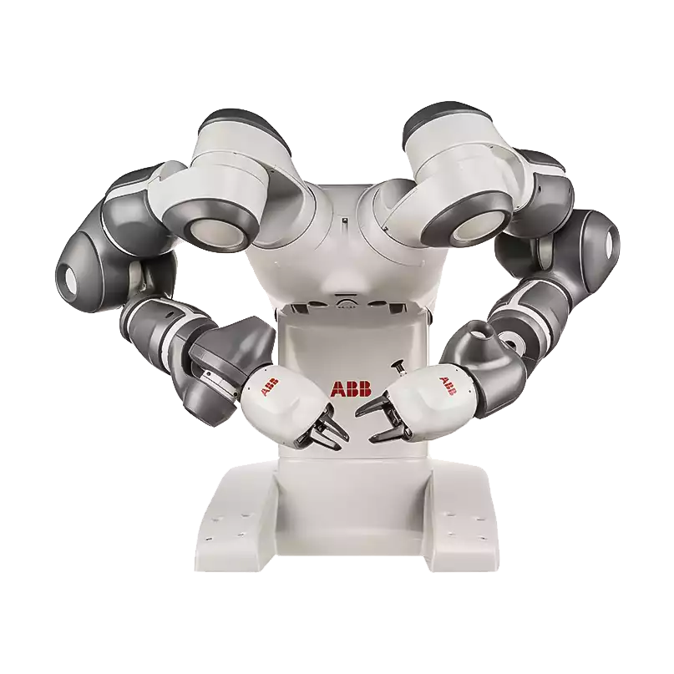

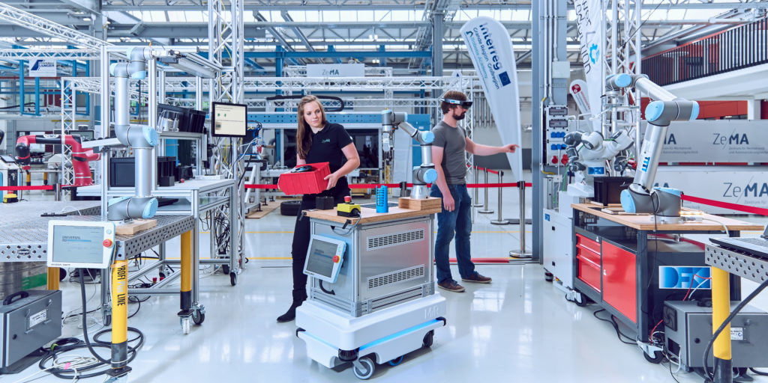
Motivation
Collaborative Robot:
Industry 4.0 strategy
Efficiency:
Increasing demand for individualised products and shorter product cycles [1].
Human-robot Collaboration (HRC):
Solution to deal with personalized production.
[1] Yoram Koren. The global manufacturing revolution: product-process-business integration and reconfigurable systems. Vol. 80. John Wiley & Sons, 2010.
https://sharework-project.eu/project/sharework-ontology-for-human-robot-collaboration-cirp-conference-2020/
https://robot-hub.org/project/human-robot-collaboration-in-industry-4-0/

Slide 4
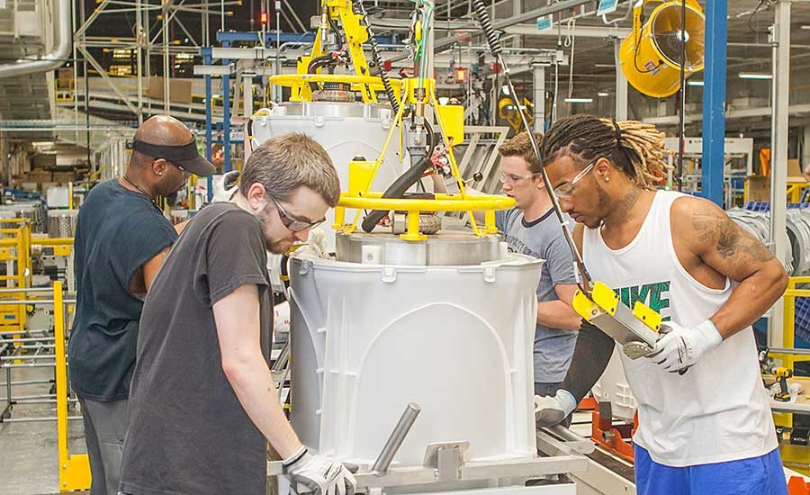
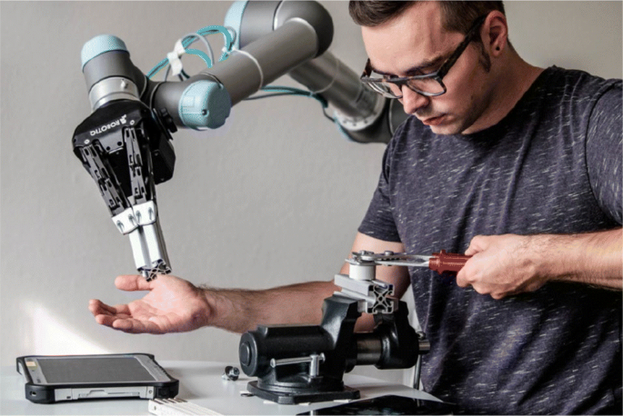
Motivation
Human Labor:
Processes rely on human operators with low efficiency.
Flexibility:
Requires robot agents with agile learning capabilities.
Productivity:
Enhances producing power and advance the development of HRC.
Gervasi, Riccardo, Luca Mastrogiacomo, and Fiorenzo Franceschini. "A conceptual framework to evaluate human-robot collaboration." The International Journal of Advanced Manufacturing Technology 108.3 (2020): 841-865.

Slide 5
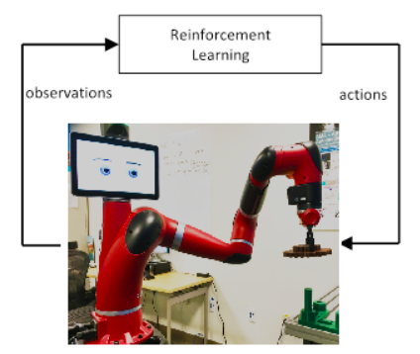


Motivation
Deep Reinforcement Learning (DRL)
Not yet been well-explored in human-in-the-loop manufacturing/production processes.
Requires a large amount of annotated training data
-> impractical [2]
Relies on the exploration of the environment
-> safety constraints [3]
[2] Afonso Castro, Filipe Silva, and Vitor Santos. “Trends of Human-Robot Collaboration in Industry Contexts: Handover, Learning, and Metrics”. In: Sensors 21 (June 2021), p. 4113. DOI: 10.3390/s21124113.
[3] Mohamed El-Shamouty et al. “Towards Safe Human- Robot Collaboration Using Deep Reinforcement Learning”. In: 2020 IEEE International Conference on Robotics and Automation (ICRA). IEEE. 2020, pp. 4899–4905.
Notes:
learns from the interaction via the environment.

Slide 6
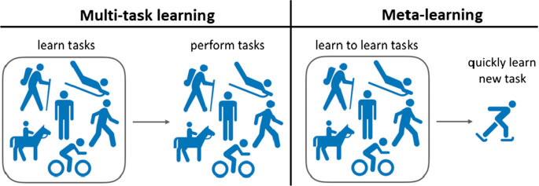
Motivation
Meta-learning, a method learning to gain prior knowledge of new tasks.
Training phase: quickly learn
Testing phase: simply observes some trials in a new task to conform to a new task that is similar to the training task
Huisman, Mike, Jan N. Van Rijn, and Aske Plaat. "A survey of deep meta-learning." Artificial Intelligence Review 54.6 (2021): 4483-4541.
Notes:
quickly learn the manufacturing tasks in the HRC process.
simply observes some trials in a new task to conform to a new task that is similar to the training task.

Slide 7
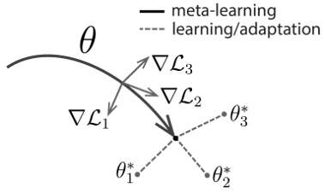
Methodology
Model diagnostic meta-learning (MAML), is used in combination with the proximal policy optimization (PPO) DRL algorithm [4,5].
Meta-reinforcement learning (meta-RL) is an algorithm that trains an agent on a set of different tasks and extracts high-level knowledge that is shared across all training tasks.
Diagram of our model-agnostic meta-learning algorithm (MAML), which optimizes for a representation θ that can quickly adapt to new tasks
[4] Chelsea Finn, Pieter Abbeel, and Sergey Levine. “Model-agnostic meta-learning for fast adaptation of deep networks”. In: Proceedings of the 34th Interna- tional Conference on Machine Learning-Volume 70. JMLR. org. 2017, pp. 1126–1135.
[5] John Schulman et al. “Proximal policy optimiza- tion algorithms”. In: arXiv preprint arXiv:1707.06347 (2017).
Notes:
Considering the research gap in the practical application of HRC in the personalised production paradigm, this capability is given to the robot in our work due to the fact that meta-learning can drive the adaptation of the robot in different HRC applications for personalised production.

Slide 8
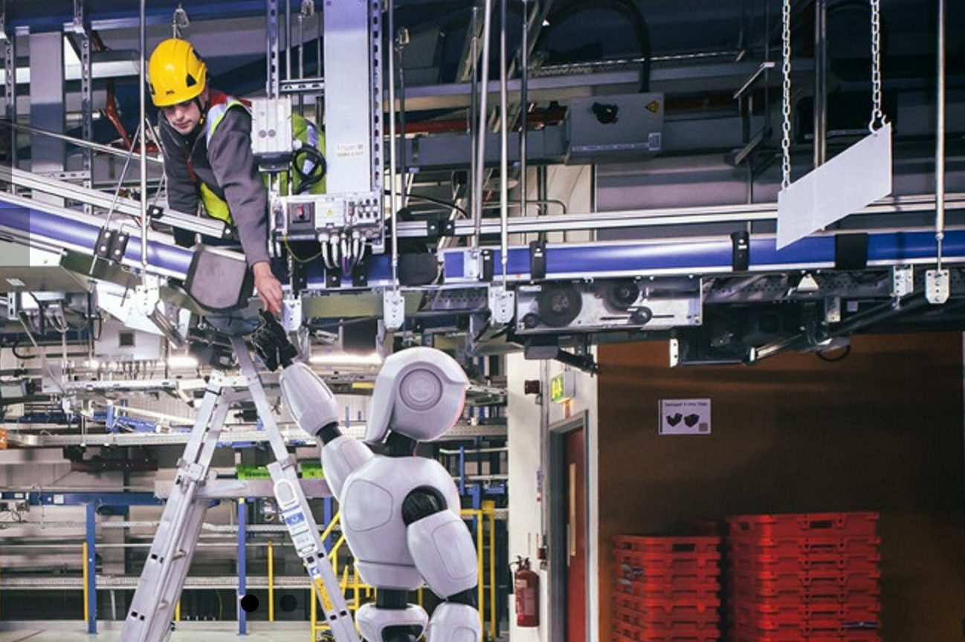
Methodology
Could the DRL-based solution improve the learning capability of the robotic system in Self-learning Robotic assisted Systems (SLRAS) and enable the robots to perform robustly to unseen HRC robot tasks?
Compared to train-from-scratch DRL, does the proposed meta-RL solution perform better in terms of training time and reward?
https://www.epfl.ch/labs/lasa/human-robot-interaction/
Notes:
Develop control strategies for robots in HRC and to verify whether meta-DRL can be quickly adapted to different manufacturing tasks in HRC.

Slide 9
Methodology
With the SLRAS proposed, which could self-adapt DRL algorithms to assist human operators by assisting with task goal setting through meta-DRL approach
To evaluate if,
DRL algorithm: improve the generality of the robot in HRC
meta-RL: increase the learning efficiency and improve the speed of adaptation
Notes:
To prove whether the DRL algorithm is used to improve the generality of the robot in HRC, enabling the robot to learn different tasks autonomously
assigns powerful learning capabilities to the robot to increase the learning efficiency and improve the speed of adaptation to HRC-assisted tasks.

Slide 10
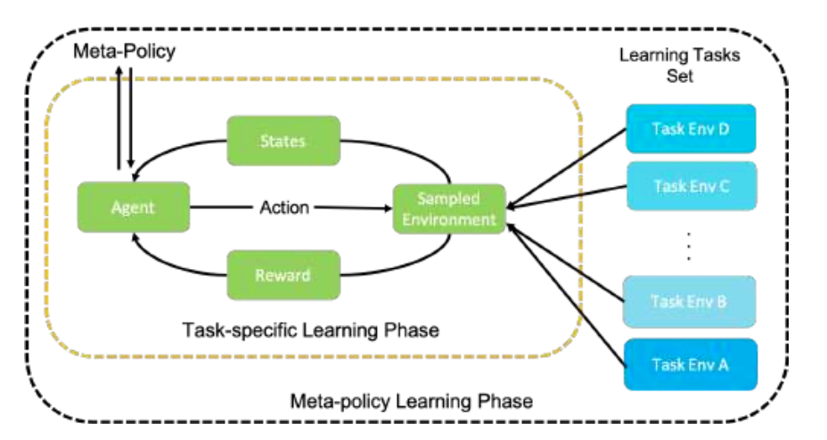
Methodology
Task-specific learning phase;
Meta-policy learning phase;
Meta-policy generalizing phase
The diagram of meta-RL learning process [6].
[6] Mathew Botvinick et al. “Reinforcement learning, fast and slow”. In: Trends in cognitive sciences (2019).
Notes:
Task-specific learning phase,
Sampling some of the robotic tasks in HRC can be learned with just a few iterations of the meta-policy [6];
Meta-policy learning phase,
Update the meta-policy with sample task data for each specific task from the previous phase [6];
Meta-policy generalizing phase,
For new tasks, after initialising the meta-policy parameters, several iterations are performed to obtain the best control policy.
[Learnable ability to adapt to new manufacturing tasks]

Slide 11
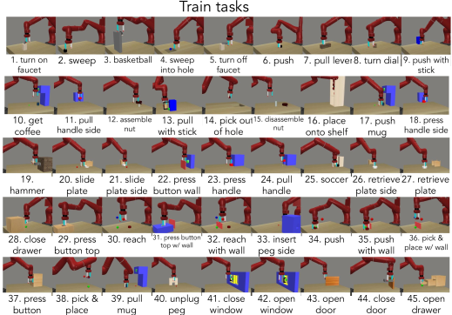
Experiments
Pre-training set:
Manipulation of different objects
Unseen sampled tasks:
Complete a specific practical use task
Notes:
where the manipulator learns to drag, pull, sweep, grasp, etc.
, such as handles, sticks, mugs. The goal is mainly to move the target object to a specified position.
, such as opening a box, closing a drawer, pressing a button.

Slide 12
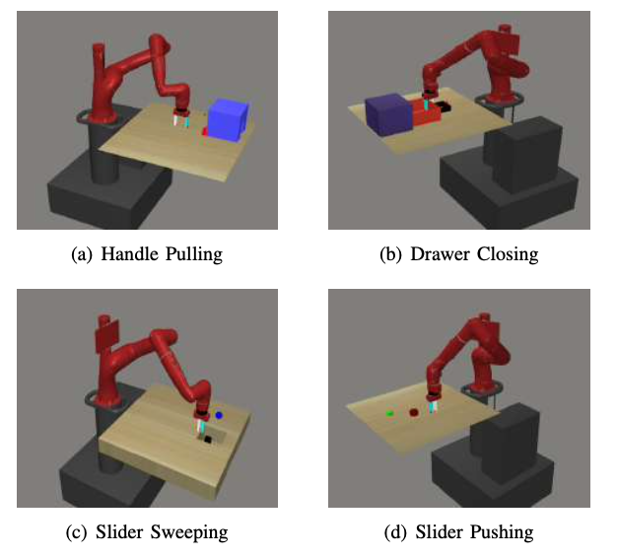
Experiments
12 robot control tasks from similar HRC tasks in meta- world [7].
Phase (1)(2): 10 pre-training tasks.
Phase (3): 2 tasks from training set + 2 unseen tasks were set as evaluation tasks.
The four scenarios in evaluating experiments.
[7] Tianhe Yu et al. “Meta-world: A benchmark and evaluation for multi-task and meta reinforcement learning”. In: Conference on Robot Learning. PMLR. 2020, pp. 1094–1100.
Notes:
12 robot control tasks were randomly selected from similar HRC tasks in meta- world
The first type is the manipulation of different objects (handles, sticks, mugs, etc.) where the manipulator learns to drag, pull, sweep, grasp, etc. The goal is mainly to move the target object to a specified position. The second type attempts to complete a specific practical use task, such as opening a box, closing a drawer, pressing a button, etc. In our evaluation experiments, the tasks were sampled from the pre-training set, i.e., pushing the slider and pulling the handle. The unseen sampled tasks were closing the drawer and sweeping the slider into the bin.

Slide 13
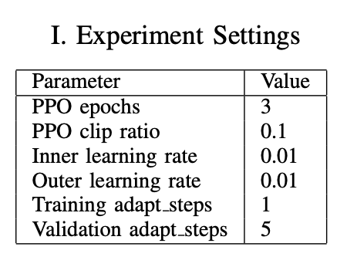
Experiments
DRL algorithm setting: A multi-layer neural network consisting of two fully connected layers with 100 hidden units in each layer.
Learning settings:
Activation function: Tanh
Optimizer: Adam
Hardware: CPU Intel Core i5- 5200U 2-Core Processor 2.20GHz and each iteration took an average of 280s.
Software Environment: Pytorch+Mujuco+Metaworld
[8] Diederik P Kingma and Jimmy Ba. “Adam: A method for stochastic optimization”. In: arXiv preprint arXiv:1412.6980 (2014).

Slide 14
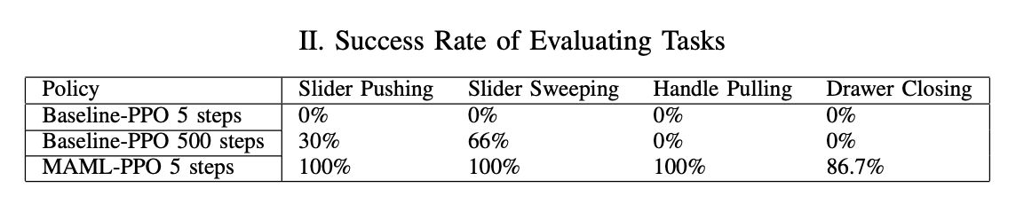
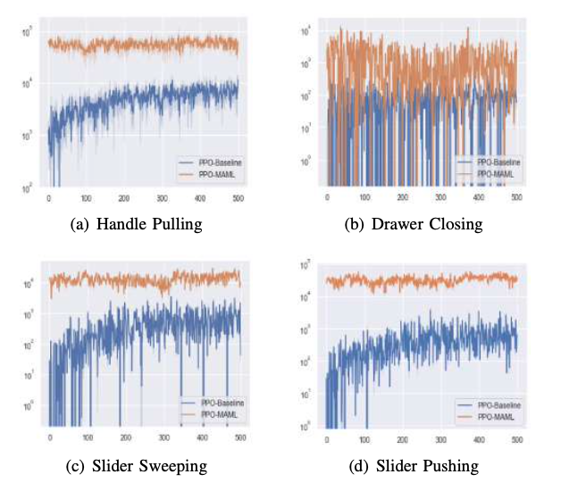
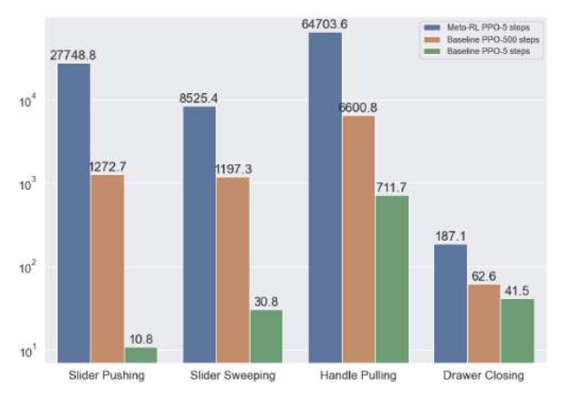
Experiment Results
The reward gained with MAML-based PPO and baseline PPO in evaluating scenarios with different learning periods
The reward curves of evaluating experiments. Higher reward value means better performance

Slide 15
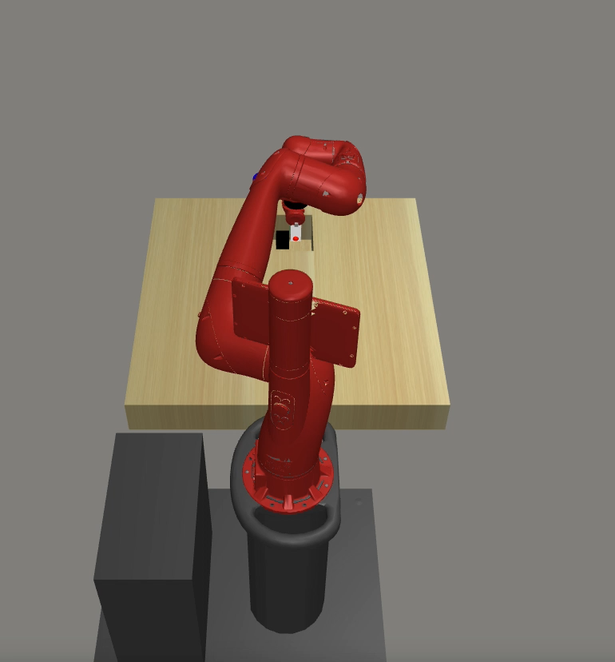
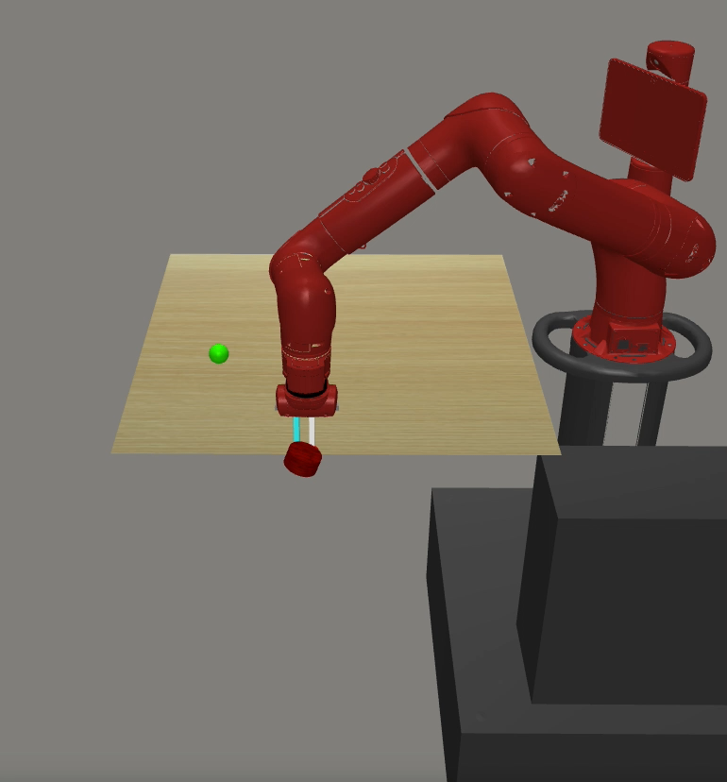
Experiment Results
Task Demonstration of cobot with MAML-PPO in 5 steps (40sec training)
Slider Sweeping
Slider Pushing

Slide 16
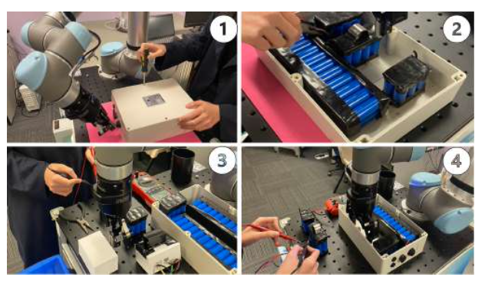
Case Study: HRC disassembly of a retired battery
HRC in small batches and customised dismantling tasks
Human: unscrews the battery box
Cobot: press a button to observe the state of the battery
Human: cuts the cable to the battery
Cobot: remove the battery from the box
Human: diagnoses the recycling value of the parts in the battery
Cobot: sweeps the disassembled parts into containers by classification
Human: receives the items
Cobot: pushes new items to the operator
Case Study of HRC for aging battery disassembly

Slide 17
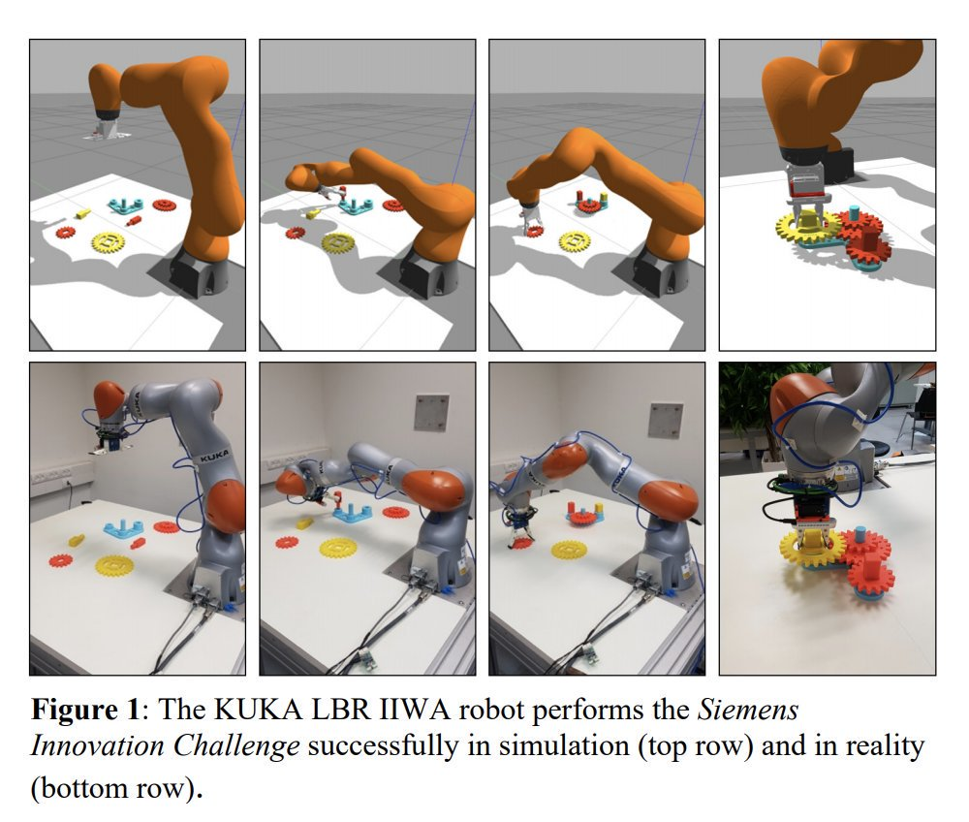
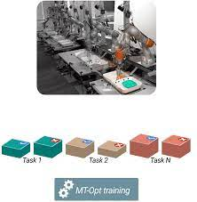
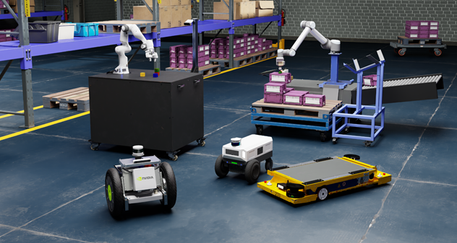
Discussions and Future Work
Simplify the model and simulation environment
Handle the task diversity
Transfer control strategies obtained in simulators to physical robots without any performance degradation
Kalashnikov, Dmitry, et al. "Scalable deep reinforcement learning for vision-based robotic manipulation." Conference on Robot Learning. PMLR, 2018.
Lee, Robert, et al. "Zero-shot sim-to-real transfer with modular priors." CoRR (2018).
Makoviychuk, Viktor, et al. "Isaac gym: High performance gpu-based physics simulation for robot learning." arXiv preprint arXiv:2108.10470 (2021).

Slide 18
Reference
[1] Yoram Koren. The global manufacturing revolution: product-process-business integration and reconfigurable systems. Vol. 80. John Wiley & Sons, 2010.
[2] Afonso Castro, Filipe Silva, and Vitor Santos. “Trends of Human-Robot Collaboration in Industry Contexts: Handover, Learning, and Metrics”. In: Sensors 21 (June 2021), p. 4113. DOI: 10.3390/s21124113.
[3] Mohamed El-Shamouty et al. “Towards Safe Human- Robot Collaboration Using Deep Reinforcement Learning”. In: 2020 IEEE International Conference on Robotics and Automation (ICRA). IEEE. 2020, pp. 4899–4905.
[4] Chelsea Finn, Pieter Abbeel, and Sergey Levine. “Model-agnostic meta-learning for fast adaptation of deep networks”. In: Proceedings of the 34th International Conference on Machine Learning-Volume 70. JMLR. org. 2017, pp. 1126–1135.
[5] John Schulman et al. “Proximal policy optimization algorithms”. In: arXiv preprint arXiv:1707.06347 (2017).
[6] Mathew Botvinick et al. “Reinforcement learning, fast and slow”. In: Trends in cognitive sciences (2019).
[7] Tianhe Yu et al. “Meta-world: A benchmark and evaluation for multi-task and meta reinforcement learning”. In: Conference on Robot Learning. PMLR. 2020, pp. 1094–1100.
[8] Diederik P Kingma and Jimmy Ba. “Adam: A method for stochastic optimization”. In: arXiv preprint arXiv:1412.6980 (2014).

Slide 19
Thank you
Q & A

